Slide 1
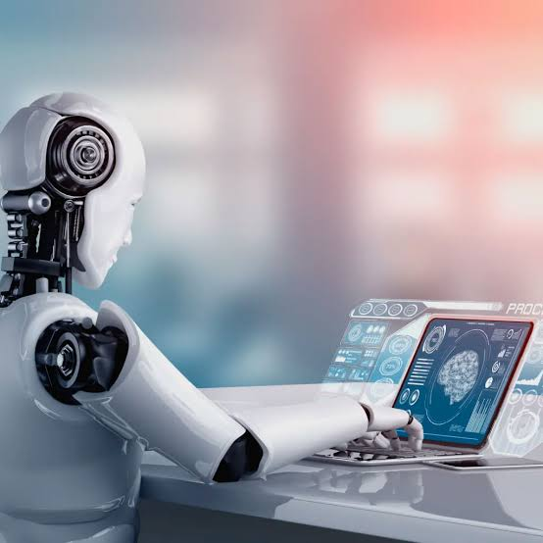
GROUP 2 PRESENTATION
Artificial
Intelligence
& Machine Learning
in Information Systems
Raghav · Shishir · Shuprabha
AI & ML in IS

Slide 2
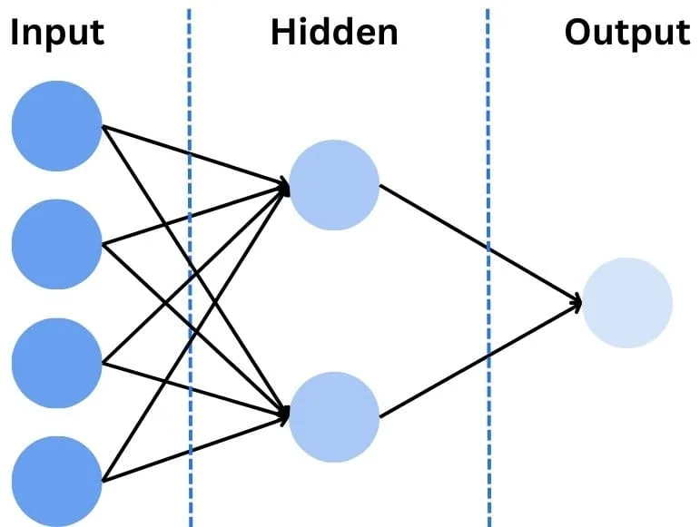
01
Introduction to AI & Machine Learning
Artificial Intelligence
The simulation{virtual copy} of human intelligence in machines that are programmed to think, reason, learn, and problem-solve autonomously.
Machine Learning
A subset of AI that enables systems to automatically learn and improve from experience without being explicitly programmed.
Deep Learning
A further subset using multi-layered neural networks to model complex patterns in data, inspired by the human brain.
Neural network visualization

Slide 3
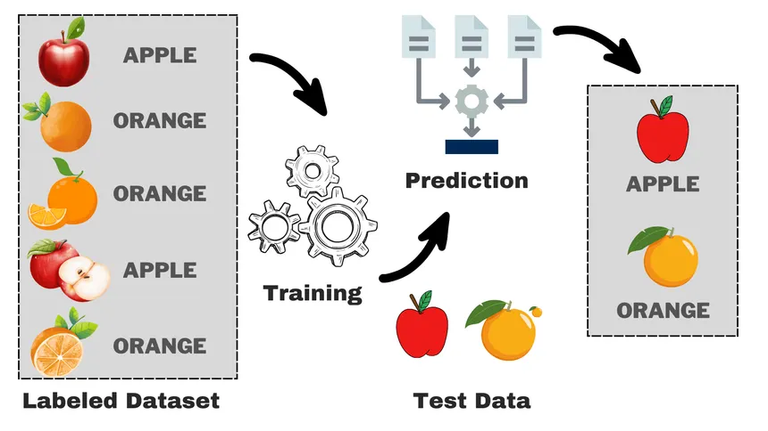
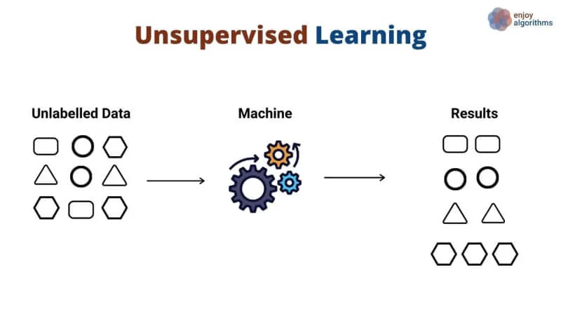
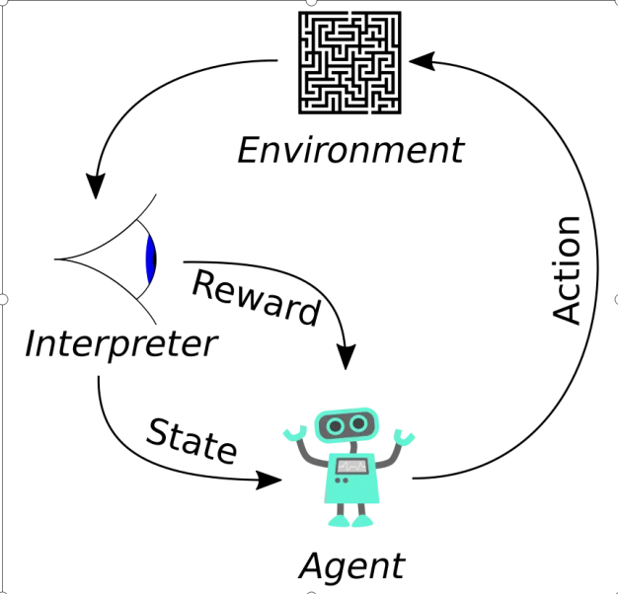
02
Types of Machine Learning
Supervised Learning
Unsupervised Learning
Reinforcement Learning
Trains on labeled data. The model learns input-output mappings to make predictions on new, unseen data.
Finds hidden patterns in unlabeled data. Discovers structure without predefined correct answers.
Learns through trial and error. An agent receives rewards or penalties based on actions in an environment.
Examples: Email spam detection, image recognition, house price prediction
Examples: Customer segmentation, anomaly detection, topic modeling
Examples: Game AI (AlphaGo), robotics, self-driving cars

Slide 4
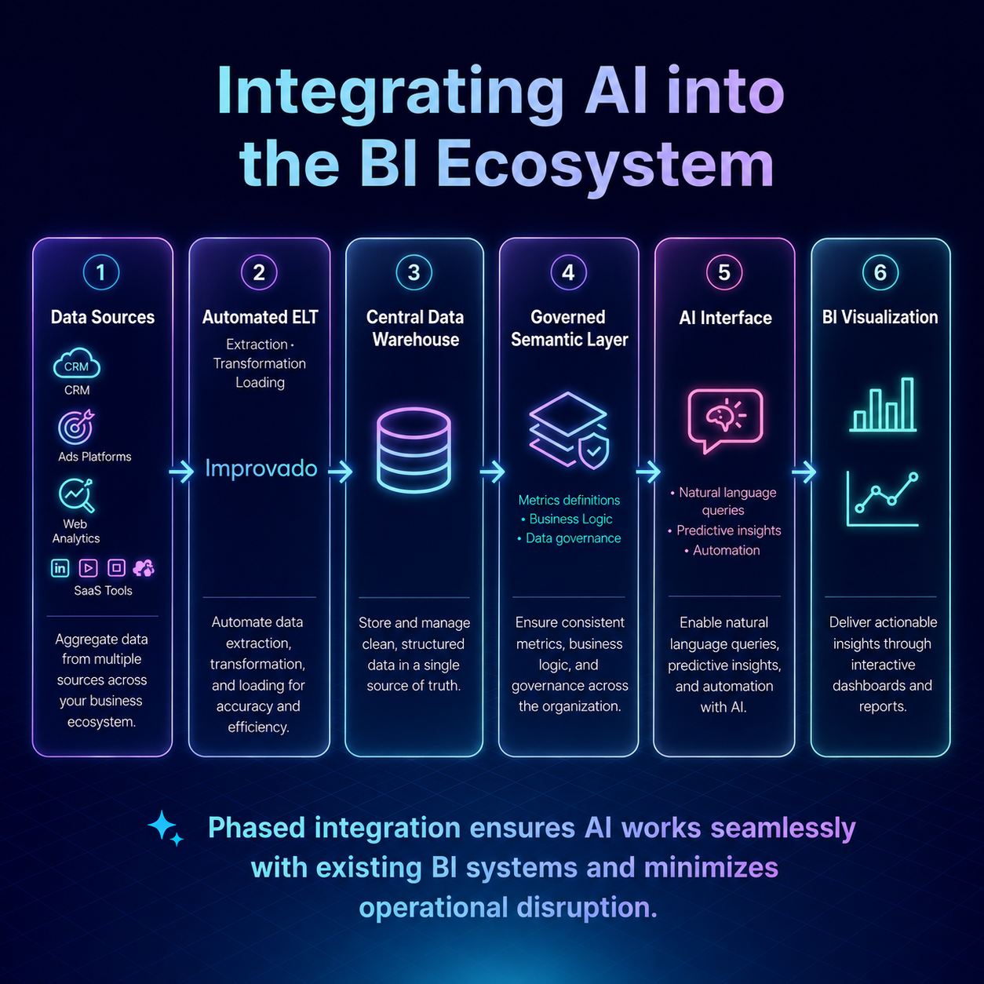
03
AI & ML Applications in Information Systems
Decision Support Systems
1
AI analyzes large datasets to help managers make data-driven decisions in real time.
Natural Language Processing
2
Enables IS to understand and generate human language — chatbots, search, translation.
Predictive Analytics
3
Forecasts trends, customer behavior, and system failures before they occur.
Intelligent Automation (RPA)
4
Automates routine IS tasks like data entry, report generation, and workflow routing.
Cybersecurity & Fraud Detection
5
AI powering business intelligence & data systems
ML models detect anomalies, intrusions, and fraudulent transactions in real time.

Slide 5
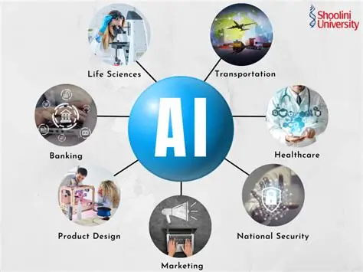

Slide 6
04
Benefits & Limitations
✅ BENEFITS
⚠️ LIMITATIONS
→ Automates repetitive & time-consuming tasks
→ High cost of data collection and training
→ Processes vast amounts of data at high speed
→ Requires large, high-quality datasets
→ Improves decision-making accuracy
→ Black-box models lack explainability
→ Personalized user experiences at scale
→ Prone to bias if training data is biased
→ Reduces human error in critical systems
→ Vulnerable to adversarial attacks
→ Enables 24/7 intelligent service delivery
→ Risk of job displacement & over-reliance

Slide 7
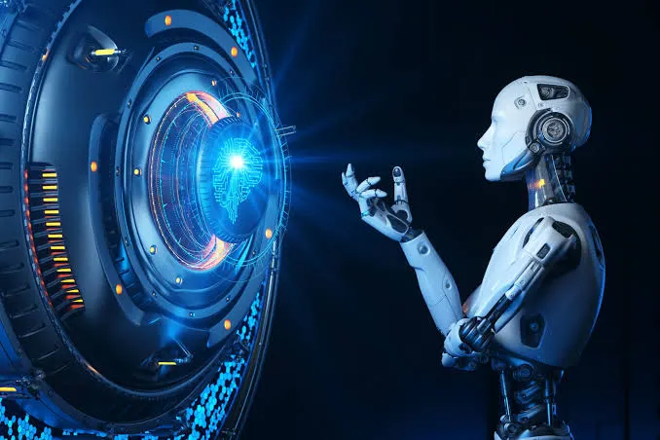
05
Ethical Concerns in AI & ML
Bias & Fairness
Privacy & Monitoring
AI can be unfair if it learns from biased data.
It may treat some people better than others.
Example: Unfair hiring, loan approval, or police decisions.
AI collects a lot of personal information.
It can track people using cameras and facial recognition.
This can reduce people's privacy.
Transparency & Explainability
Job Displacement
Sometimes AI gives answers without explaining why.
People should understand how AI makes decisions.
AI and robots can do many human jobs.
This may reduce jobs, especially repetitive work.
Workers need new skills for future jobs.
AI ethics at the frontier of technology & society
Accountability
Misinformation & Deepfakes
If AI makes a mistake, who is responsible?
The company, developer, or user should be accountable.{ka laee xopne kai bhayo bhane }
AI can create fake photos, videos, and news.
These can spread false information and confuse people.{rasmika mandana case}
"AI is powerful, but it should be fair, safe, and responsible. We must use AI in a way that helps people without causing harm.
AI धेरै उपयोगी छ, तर यसलाई न्यायपूर्ण, सुरक्षित र जिम्मेवारीका साथ प्रयोग गर्नुपर्छ। AI ले मानिसलाई सहयोग गर्नुपर्छ, हानि होइन।

Slide 8




06
Real-World Examples
Google
Tesla
Microsoft
Amazon
🔍 Google Search – Finds the best search results.
🚗 Self-Driving Cars – Helps cars drive safely.
🤖 Microsoft Copilot – Helps write documents and code.
🛒 Product Recommendations – Suggests products you may like.
🌐 Google Translate – Translates languages.
👀 Detects Roads & Objects – Uses cameras and AI.
☁️ Azure AI – AI tools for businesses.
🗣️ Alexa – Voice assistant that answers questions.
📧 Gmail Smart Reply – Suggests quick email replies.
🔄 Optimus Humanoid Robot – Tesla is developing Optimus, a humanoid robot.
💼 LinkedIn AI – Suggests jobs and connections.
📦 Warehouse Robots – Helps pack and move products.
📷 Google Photos – Finds people, places, and objects in your photos.
⚡ Battery Management – Makes battery use more efficient. like advance regenerative braking system
🔎 Bing AI Search engine– Gives smarter search results.
☁️ AWS AI Services – AI tools for developers and companies.

Slide 9


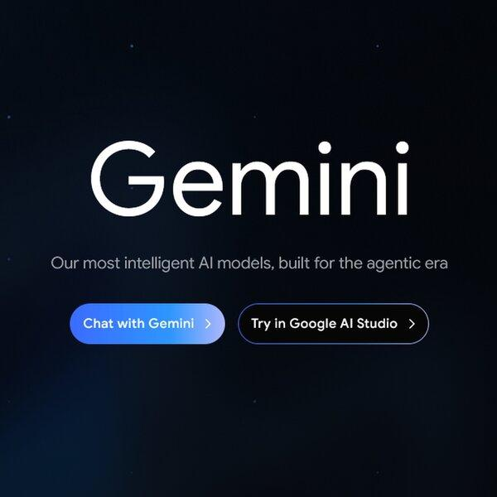
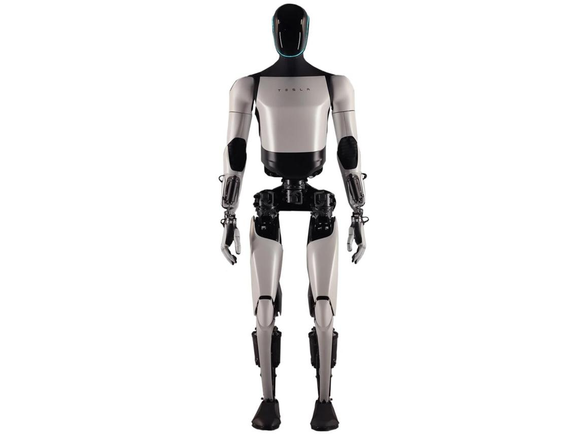
popular ai tool and product
Google: gemini
tesla: Humanoid Robot
microsoft:copilot
amazon:alexa

Slide 10


